Slide 1

Introductory Session On
Kashfi Uddin
MME’19,CUET

Slide 2
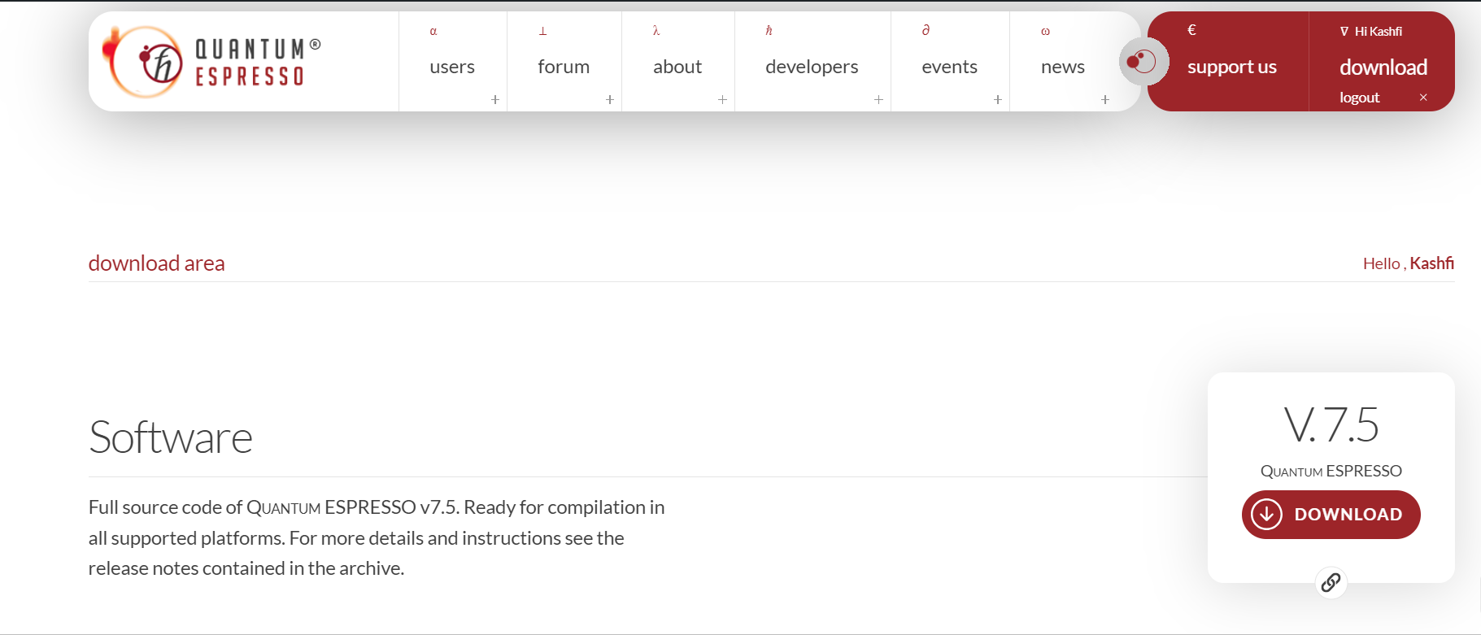
Installation
./configure
make all
Check bin folder

Slide 3
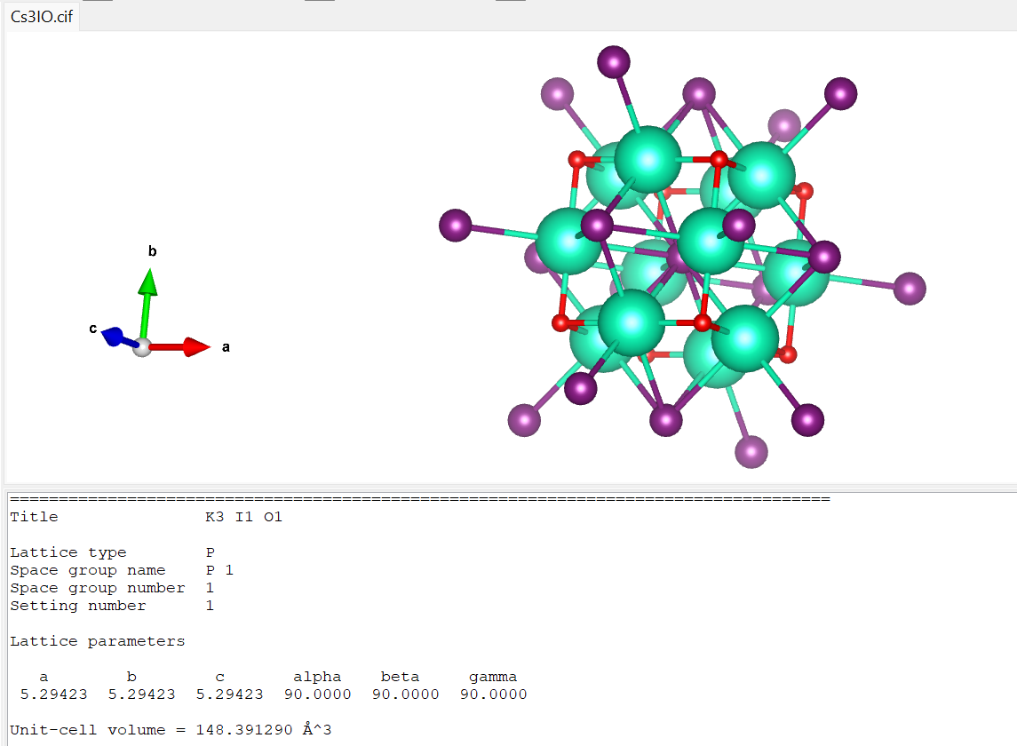
Build Structure
VESTA

Slide 4
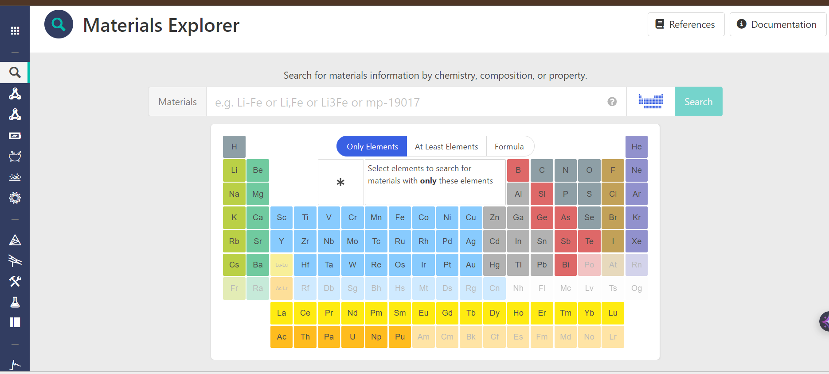
Get Existing Materials (Materials Project)

Slide 5
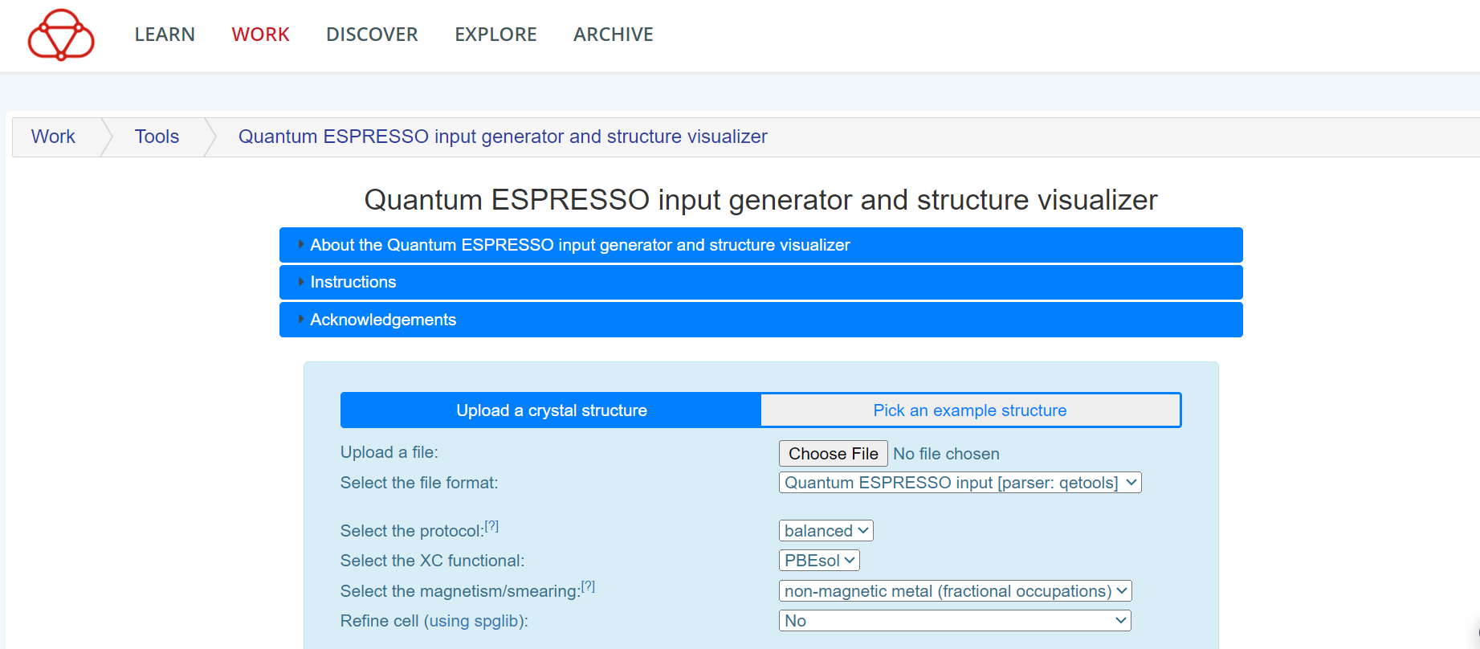
Input File Generator

Slide 6
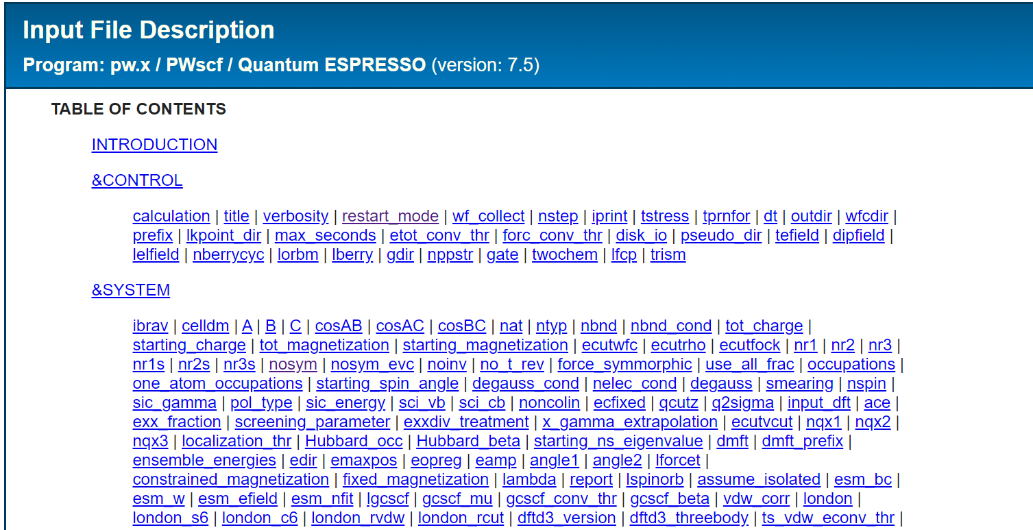
Input File Description

Slide 7
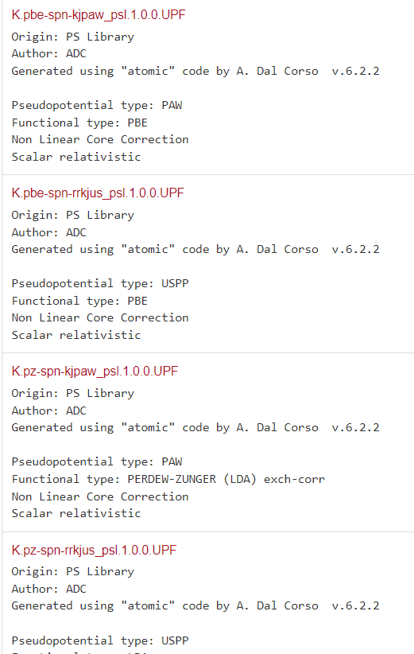
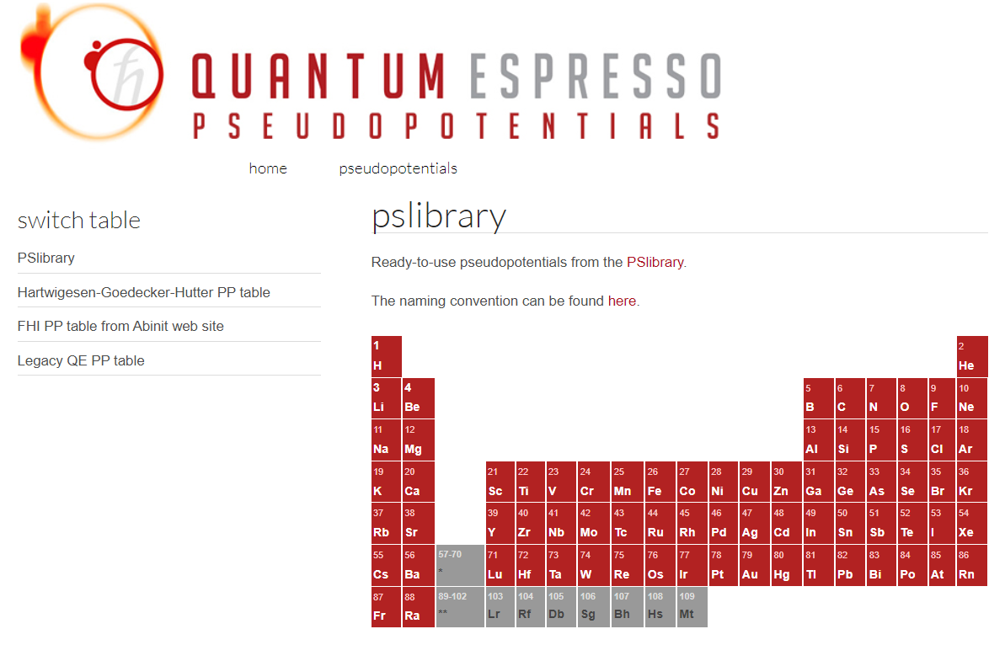
Pseudo Potentials

Slide 8
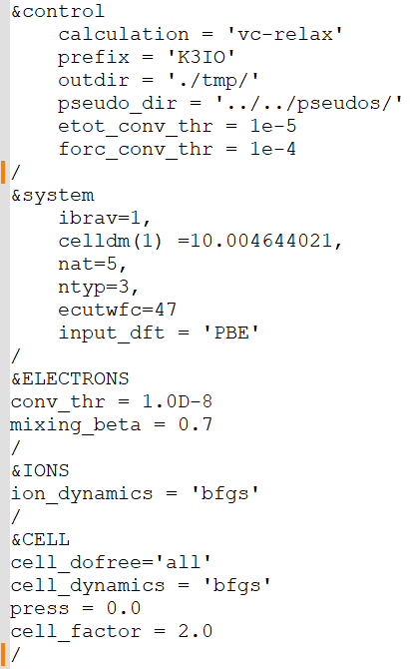
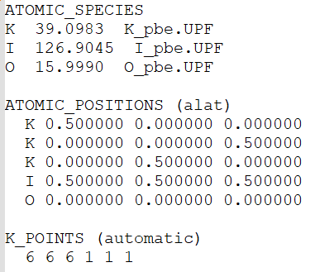
Relaxation/Geometry Optimization
relax.in
mpirun –np 4 pw.x –in relax.in | tee relax.out

Slide 9
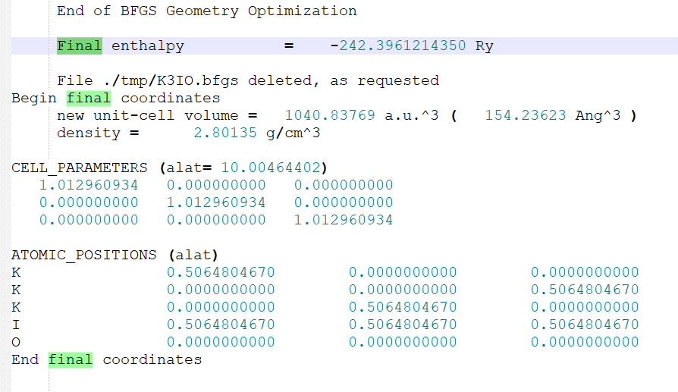
Relaxed Structure
relax.out

Slide 10
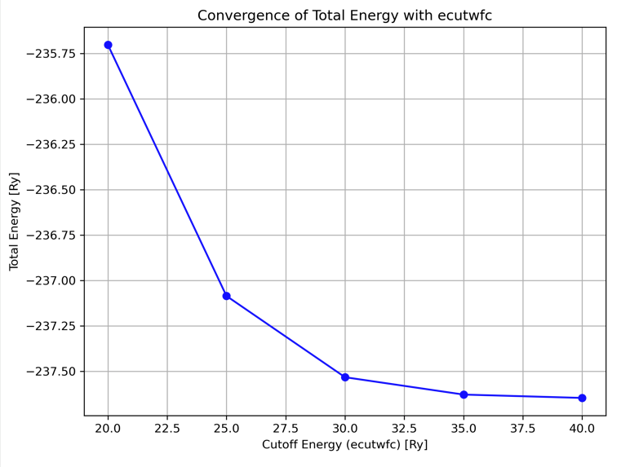
Self Consistent Field
mpirun –np 4 pw.x –in scf.in | tee scf.out
Insert the relaxed cell parameter and atomic positions
calculation=‘scf’

Slide 11
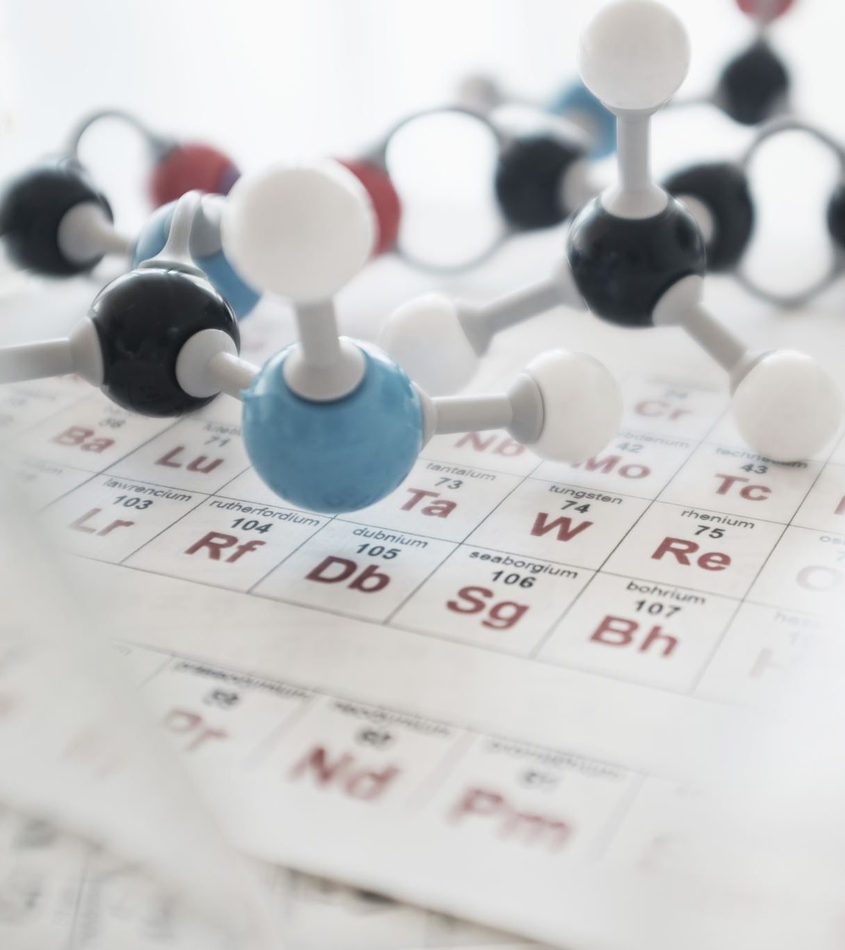
Functional Properties
Structural
Electronic
Optical
Mechanical
Thermoelectrical

Slide 12
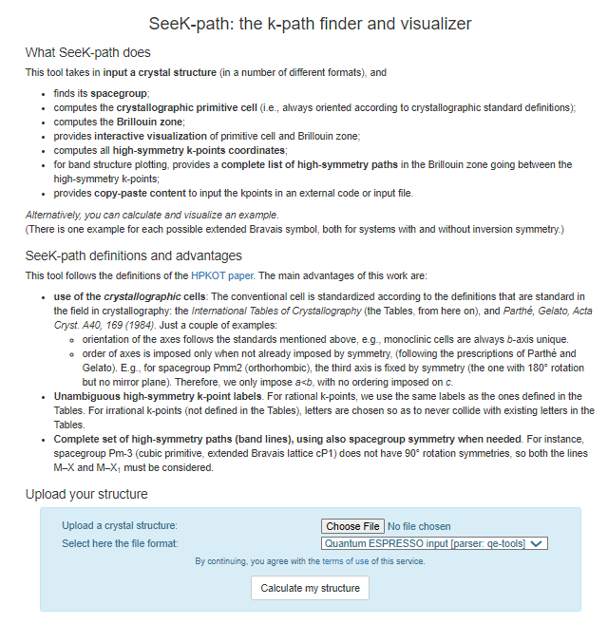
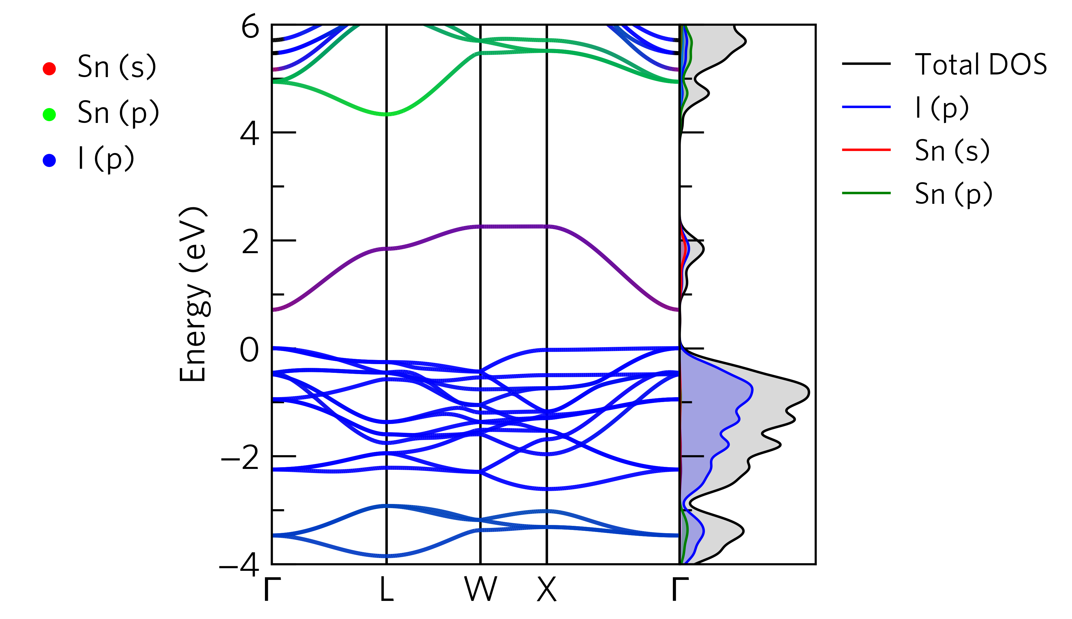
Electronic Properties
Insert K-Path instead of K-Points grid
calculation=‘bands’

Slide 13
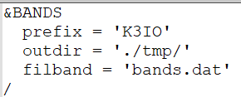
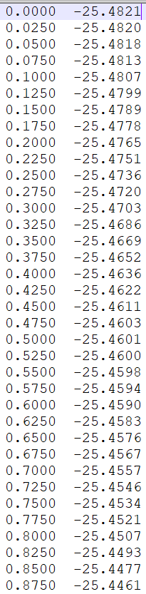
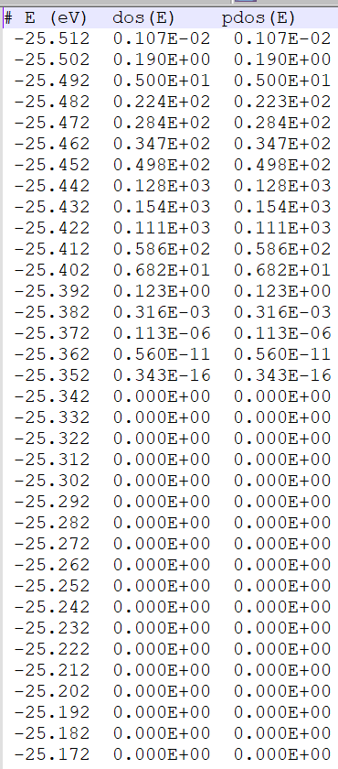
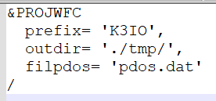
Bands Structure and DOS data
mpirun –np 4 bands.x –in band.in | tee band.out
mpirun –np 4 projwfc.x –in pdos.in | tee pdos.out

Slide 14
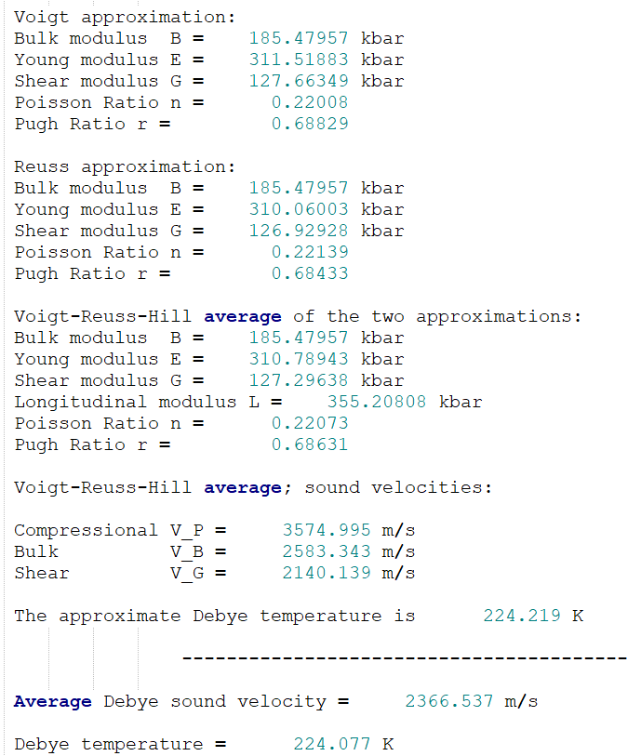
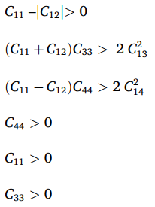
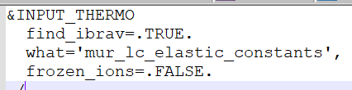
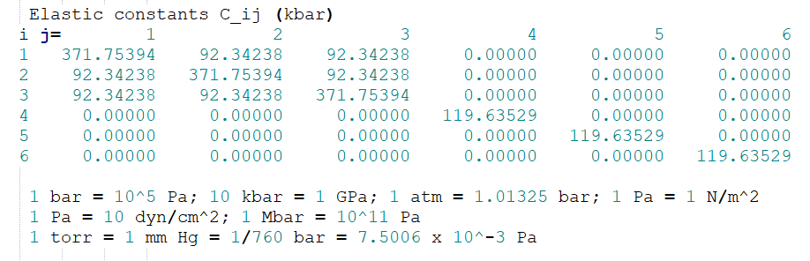
Mechanical Properties
mpirun –np 4 thermo_pw.x –in mecha.in | tee mecha.out

Slide 15
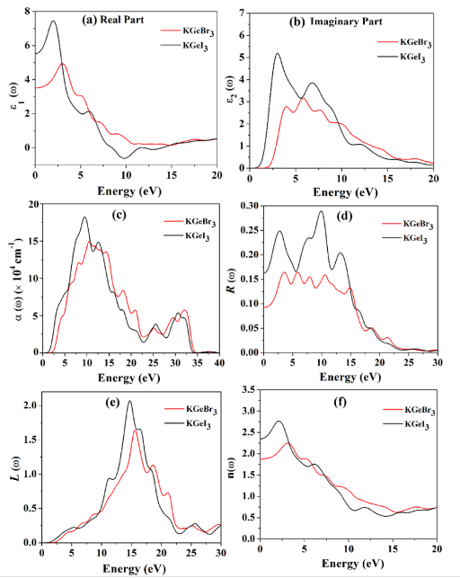
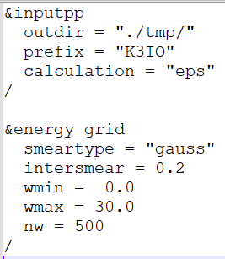
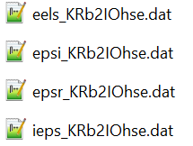
Optical Properties
mpirun –np 4 epsilon.x –in optical.in | tee optical.out

Slide 16
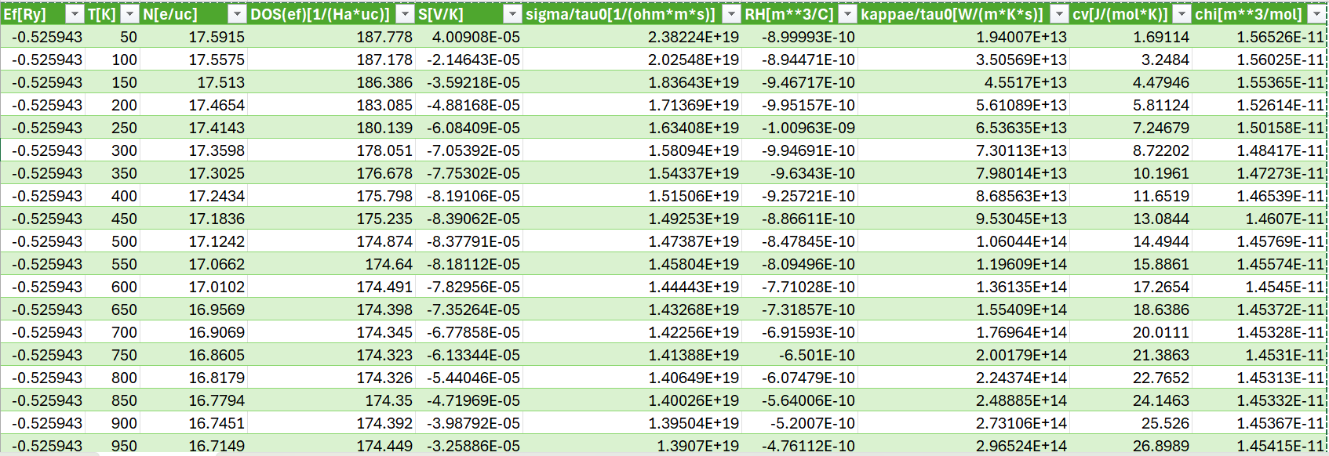
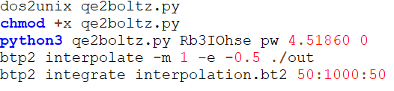
Thermoelectric Properties
N | Carrier concentration
S | Seebeck coefficient
σ | Electrical conductivity
τ | Relaxation time
κ | Thermal conductivity
κ_app | Apparent thermal conductivity
C_v | Specific heat at constant volume
χ | Susceptibility

Slide 17
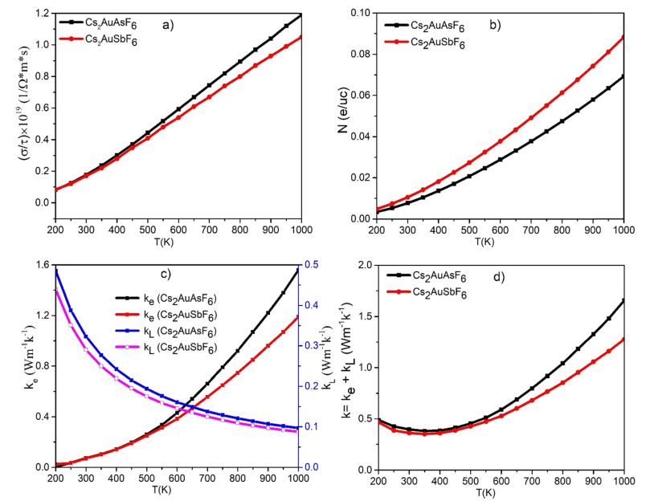
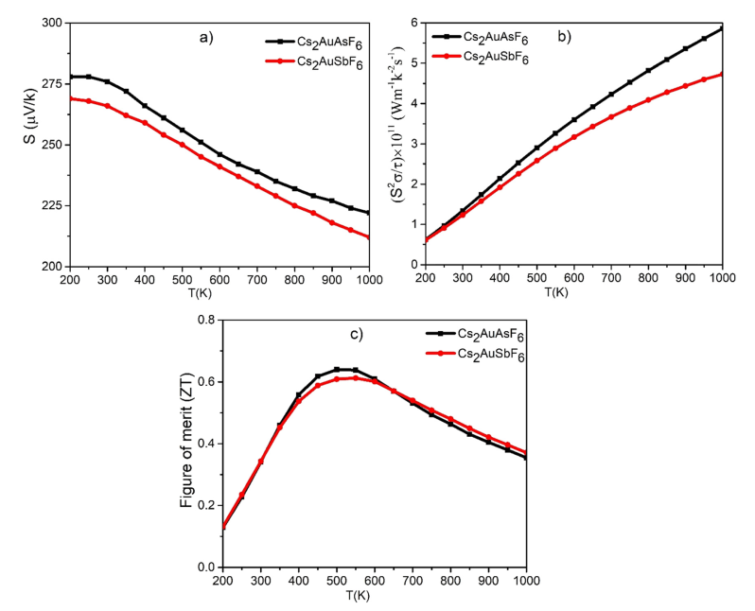

Slide 18
Outline
DFT
Pseudo Potential
Exchange-Correlation
Relaxation
SCF
Functional Properties
Many Body problem
Kohn-Sham State
Schrodinger Equation

Slide 19
Density Functional Theory
Density of what?
What is Functional?
What is the ultimate theory?

Slide 20
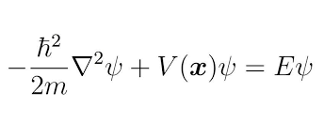

Schrodinger Equation
Properties are related to the energy
The Hamiltonian is the machine that tells the total energy of a system
The eigenvalue is the energy of that wave

Slide 21
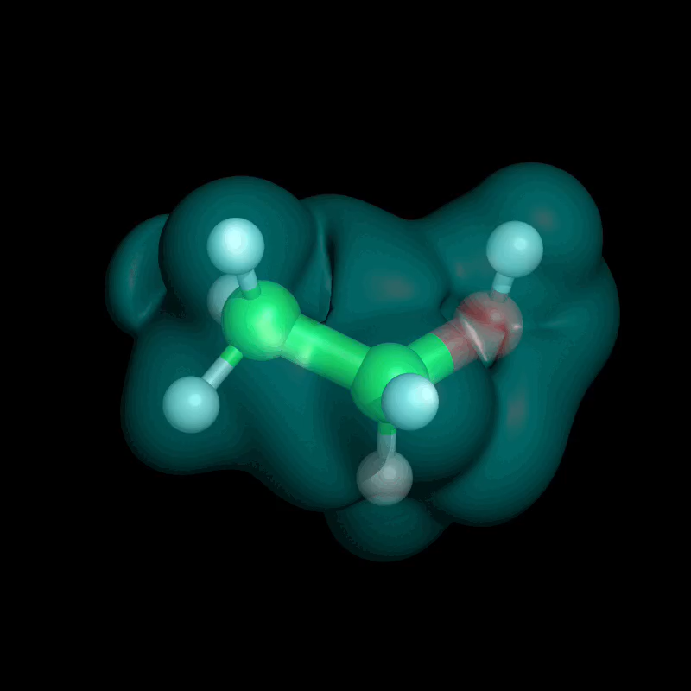
Many Body Problem

Slide 22
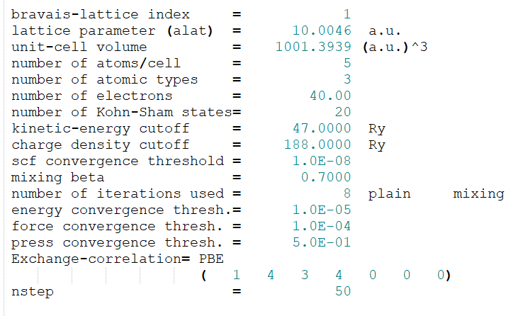

Kohn-Sham State
Imaginary single-electron states
Non-interacting electrons

Slide 23

Please Scan
Thank You

